Slide 1
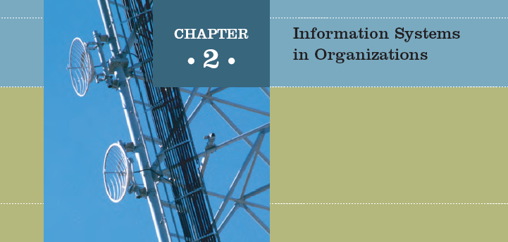

Slide 2

The use of information systems to add value to the organization is strongly influenced by organizational structure, culture, and change
Identify the value-added processes in the supply chain and describe the role of information systems within them
Provide a clear definition of the terms organizational structure, culture, and change and discuss how they affect the implementation of information systems

Slide 3
Because information systems are so important, businesses need to be sure that improvements or completely new systems help lower costs, increase profits, improve service, or achieve a competitive advantage
Identify some of the strategies employed to lower costs or improve service
Define the term competitive advantage and discuss how organizations are using information systems to gain such
an advantage
Discuss how organizations justify the need for information systems

Slide 4
Information systems personnel are the key to unlocking the potential of any new or modified system
Define the types of roles, functions, and careers available in information systems

Slide 5
Organizations and Information Systems
Organization: a formal collection of people and other resources established to accomplish a set of goals
An organization is a system
  Inputs to the system: resources such as materials, people, and money
  Outputs to the environment: goods or services

Slide 6
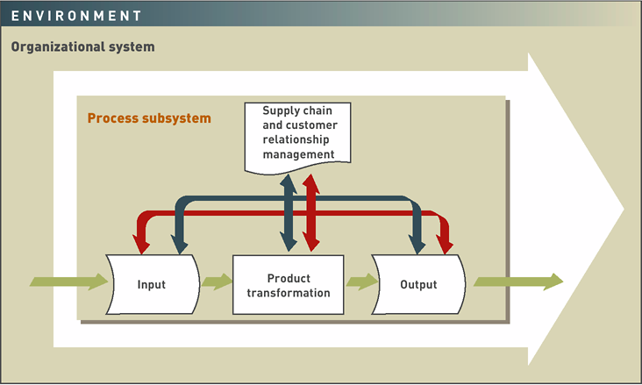
Figure 2.1: A General Model of an Organization

Slide 7
Organizations and Information Systems (continued)
Value chain: a series (chain) of activities that includes inbound logistics, warehouse and storage, production, finished product storage, outbound logistics, marketing and sales, and customer service
Upstream management: management of raw materials, inbound logistics, and warehouse and storage facilities
Downstream management: management of finished product storage, outbound logistics, marketing and sales, and customer service

Slide 8
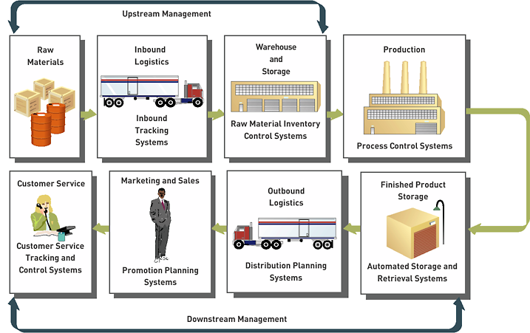
Figure 2.2: The Value Chain of a Manufacturing Company

Slide 9
Organizational Structure
Organizational structure: organizational subunits and their relationship with the overall organization
Categories of organizational structure:
  Traditional
  Project
  Multidimensional
  Virtual

Slide 10
Traditional Organizational Structure
A hierarchical structure
Major department heads report to a president or top-level manager
A managerial pyramid shows the hierarchy of decision making and authority

Slide 11
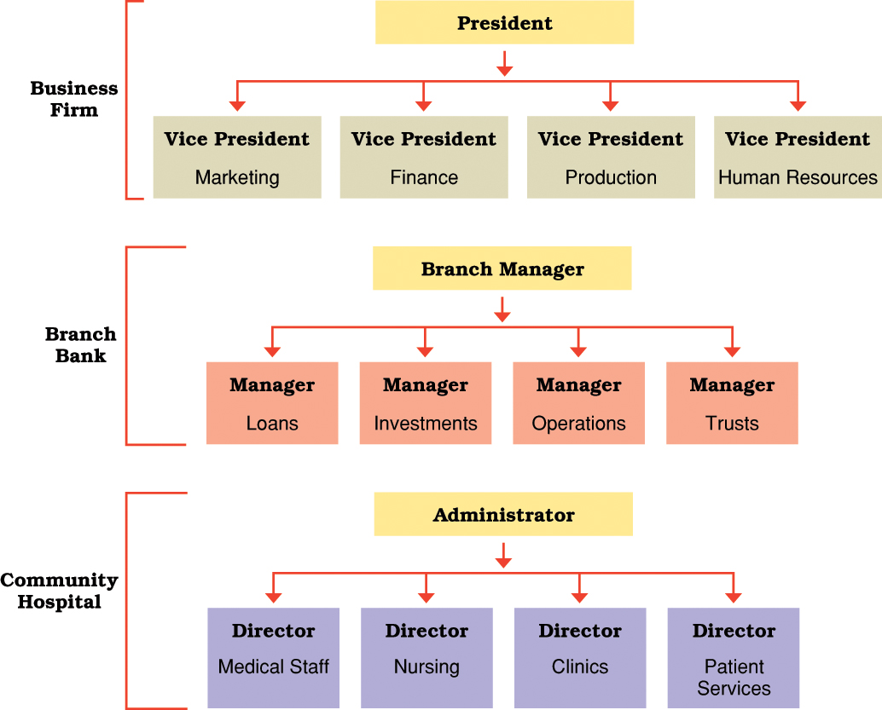
Traditional Organization structures in a business, branch bank, and community hospital

Slide 12
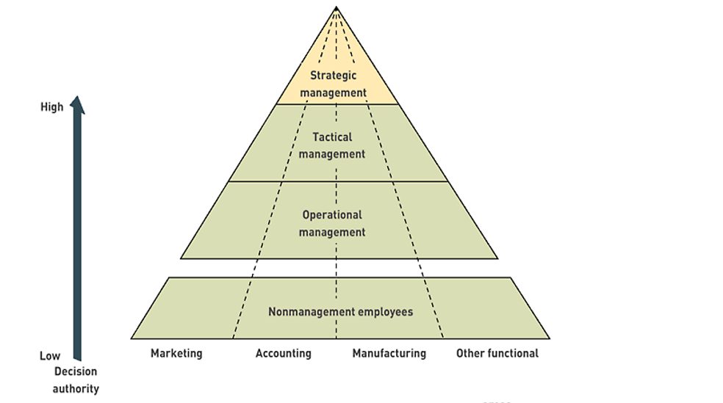
A simplified organizational model, showing the managerial pyramid

Slide 13
Project Organizational Structure
is an essential configuration for determining the hierarchy of people, their function, workflow and reporting system.
Centered around major products or services
Temporary project teams

Slide 14

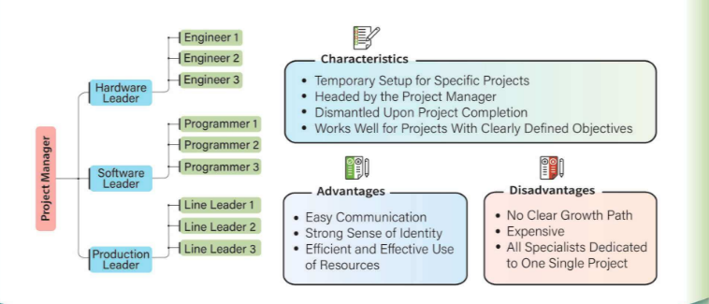
Project Organizational Structure

Slide 15
Multidimensional Organizational Structure
May incorporate several structures at the same time
Advantage: ability to simultaneously stress both traditional corporate areas and important product lines
Disadvantage: multiple lines of authority

Slide 16
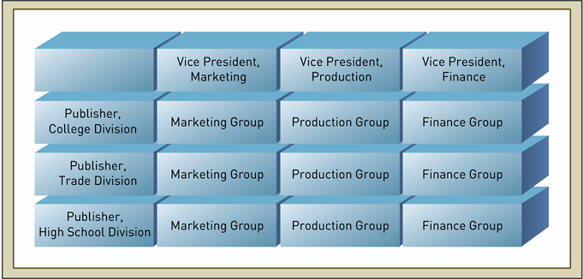
Figure 2.6: A Multidimensional Organizational Structure

Slide 17
Virtual Organizational Structure
development that involves different locations
team executes a project in one area, you can manage it from any other place.
distribute resources to your project team regardless of location.
People may never meet face to face
Amazon.com and eBay both are virtual organizations those provides online auction facilities to customers worldwide.
Both organizations operate its business in different countries with separate website and several functions

Slide 18
Virtual Organizational Structure (cont.)
Advantages
  Faster and cost-effective as there are no boundaries to work and communication.
  Lower operating costs as no permanent set up required (no need for office premises)
  Have several options like part-time work, job-sharing, and home-based working
  Employee satisfaction and efficiency

Slide 19
Virtual Organizational Structure (cont.)
Disadvantages
  No physical contact or communication, thus, lacks team integrity
  Resources require training for virtual interaction
  Different time zones cause delayed responses

Slide 20
Organizational Culture and Change
Organizational culture: a set of values that guide the behavior of organization members
Defines the content of what a new employee needs to learn to become an accepted member of an organization

Slide 21
Levels of Organizational Culture
Artifacts: are visible elements or signs that you can see with the naked eye when you walk into an organization, i.e., logos, architecture, clothing, behavior, language, architecture. High visibility
Values: are the values and rules of conduct that are adopted over time from every leader that comes into an organization; each leader brings their own set of values and rules of conduct. guides to behavior. Hard for newcomer to see, but can learn them
  Espoused values: what people say
  In-use values: what people do
Basic assumptions: like values but often unclear to veteran members

Slide 22
Levels of Organizational Culture (Cont.)
Artifacts/physical
characteristics
High visibility
Values
(Espoused;
In-use)
Basic
assumptions
Low visibility

Slide 23
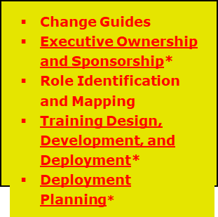
Change Management Framework
Project Definition
Process Design
Define What Is Changing
Manage the Transition
Benefits
Business Case
As-Is Process
Mapping
To-Be Process
Mapping
Recommend
Preferred
Alternative
Organization Design
Stakeholder Analysis*
HR Alignment
Benefits Realization / Value Delivery
Business Impact Assessments
Ongoing Monitoring of Changes
Business Readiness Assessment / Planning
Communications*
Business Engagement
Check Points
Notes:
So, what is good organizational change management and how does it limit dips in performance?
It starts at the beginning of the project and goes past go-live.
It’s important to communicate throughout the project and take checkpoints along the way to measure business (end-user) engagement.
Project Definition/Process Design:
Include key stakeholders in the vision and design of the change.
What are their goals, their objectives.
What would make their jobs/lives better?
What don’t they like about the current processes/technologies?
Define the business case. What is the value they are expecting from the change, the new technologies?
Important to make them feel like owners of the change, get their buy-in. This is a critical step.

Slide 24
Reengineering
Business
processes
IT
systems
Software
applications
Reengineering

Slide 25
Business Process Reengineering
Business definition. Business goals are identified within the context of four key drivers: cost reduction, time reduction, quality improvement, and personnel development and empowerment.
Process identification. Processes that are critical to achieving the goals defined in the business definition are identified.
Process evaluation. The existing process is thoroughly analyzed and measured.
Process specification and design. Based on information obtained during the first three BPR activities, use-cases are prepared for each process that is to be redesigned.
Prototyping. A redesigned business process must be prototyped before it is fully integrated into the business.
Refinement and instantiation. Based on feedback from the prototype, the business process is refined and then instantiated within a business system.

Slide 26
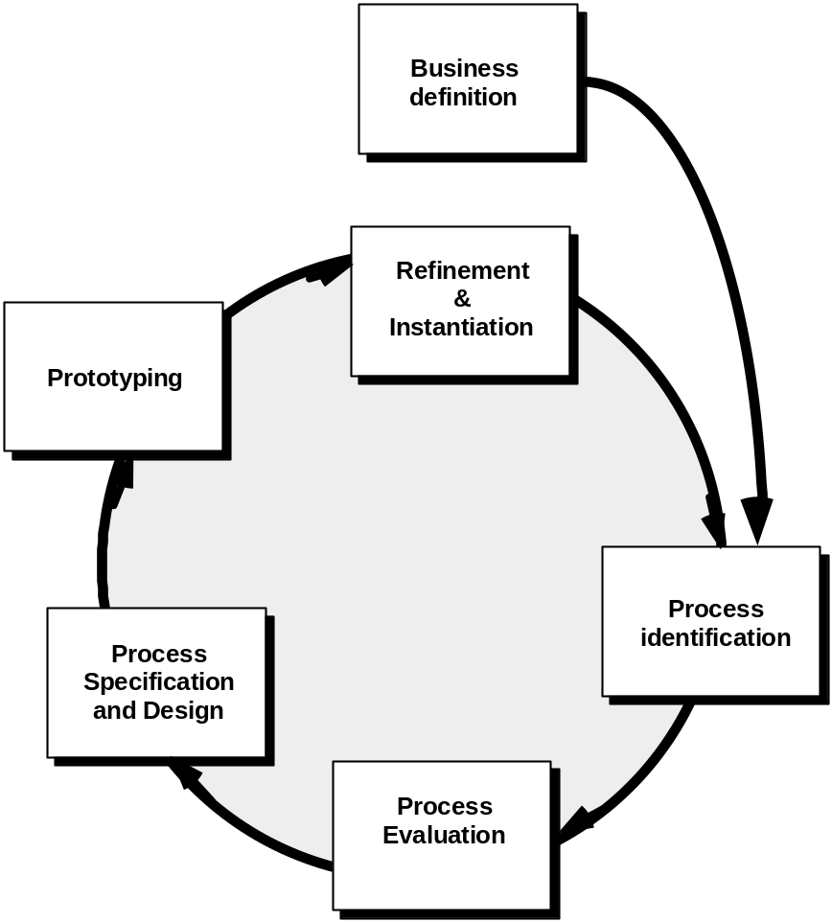
Business Process Reengineering

Slide 27
SOFTWARE REENGINEERING
RESTRUCTURING - Transforming unstructured code into structured code equivalent
REENGINEERING - “clean up” old software without affecting user functionality
REVERSE ENGINEERING - Uncover or rediscover the design specification from existing code; then apply forward engineering

Slide 28
Software Reengineering
Forward
engineering
inventory
analysis
Data
restructuring
document
restructuring
code
restructuring
reverse
engineering

Slide 29
Inventory Analysis
build a table that contains all applications
establish a list of criteria, e.g.,
  name of the application
  year it was originally created
  number of changes made to it
  total effort applied to make these changes
  date of last change
  effort applied to make the last change
  system(s) in which it resides
  applications to which it interfaces, ...
analyze and prioritize to select candidates for reengineering

Slide 30
Document Restructuring
Weak documentation is the trademark of many legacy systems.
But what do we do about it? What are our options?
Options …
  Creating documentation is far too time consuming. If the system works, we’ll live with what we have. In some cases, this is the correct approach.
  Documentation must be updated, but we have limited resources. It may not be necessary to fully redocument an application.
  The system is business critical and must be fully redocumented. Even in this case, an intelligent approach is to pare documentation to an essential minimum.

Slide 31
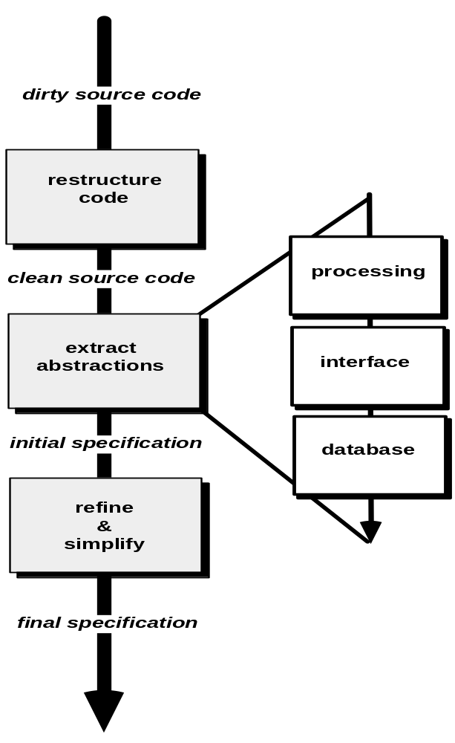
Reverse Engineering

Slide 32
REVERSE ENGINEERING
Business
Functions
Program
Source
Code
Structure
Chart
Data Flow
Diagram
Business
Functions
& Data
Object-Oriented Model

Slide 33
Code Restructuring
Source code is analyzed using a restructuring tool.
Poorly design code segments are redesigned
Violations of structured programming constructs are noted and code is then restructured (this can be done automatically)
The resultant restructured code is reviewed and tested to ensure that no anomalies have been introduced
Internal code documentation is updated.

Slide 34
Data Restructuring
Data structuring is a full-scale reengineering activity
In most cases, data restructuring begins with a reverse engineering activity.
  Current data architecture is dissected and necessary data models are defined (Chapter 9).
  Data objects and attributes are identified, and existing data structures are reviewed for quality.
  When data structure is weak (e.g., flat files are currently implemented, when a relational approach would greatly simplify processing), the data are reengineered.

Slide 35
REVERSE ENGINEERING
Data
Dictionary
Business
Data
Program
Source
Code
Entity-Relationship
Diagram
Business
Functions
& Data
Object-Oriented Model

Slide 36
Forward Engineering
1. The cost to maintain one line of source code may be 20 to 40 times the cost of initial development of that line.
2. Redesign of the software architecture (program and/or data structure), using modern design concepts, can greatly facilitate future maintenance.
3. Because a prototype of the software already exists, development productivity should be much higher than average.
4. CASE tools for reengineering will automate some parts of the job.
5. A complete software configuration (documents, programs and data) will exist upon completion of preventive maintenance.

Slide 37
Economics of Reengineering-I
A cost/benefit analysis model for reengineering has been proposed by Nine parameters are defined:
    P₁ = current annual maintenance cost for an application.
    P₂ = current annual operation cost for an application.
    P₃ = current annual business value of an application.
    P₄ = predicted annual maintenance cost after reengineering.
    P₅ = predicted annual operations cost after reengineering.
    P₆ = predicted annual business value after reengineering.
    P₇ = estimated reengineering costs.
    P₈ = estimated reengineering calendar time.
    P₉ = reengineering risk factor (P₉ = 1.0 is nominal).
    L = expected life of the system.

Slide 38
Economics of Reengineering-II
The cost associated with continuing maintenance of a candidate application (i.e., reengineering is not performed) can be defined as
C_{maint} = [P₃ - (P₁ + P₂)] x L
The costs associated with reengineering are defined using the following relationship:
C_{reeng} = [[P₆ - (P₄ + P₅)] x (L - P₈)]] - (P₇ x P₉)] `
Using the costs presented in equations above, the overall benefit of reengineering can be computed as
cost benefit = C_{reeng} - C_{maint}

Slide 39
End of Presentation

